Slide 1
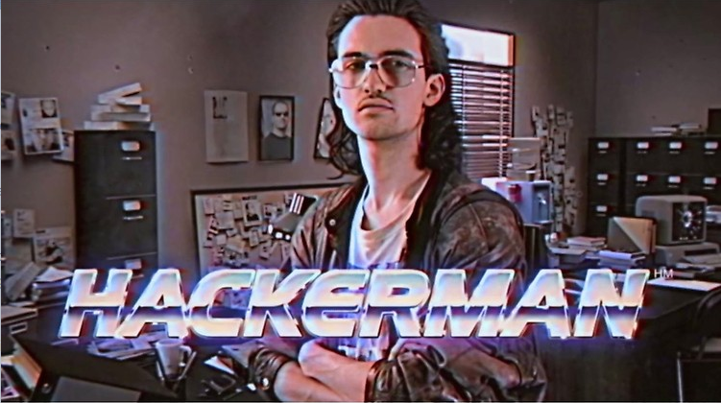
The C-I-A Triad

Slide 2
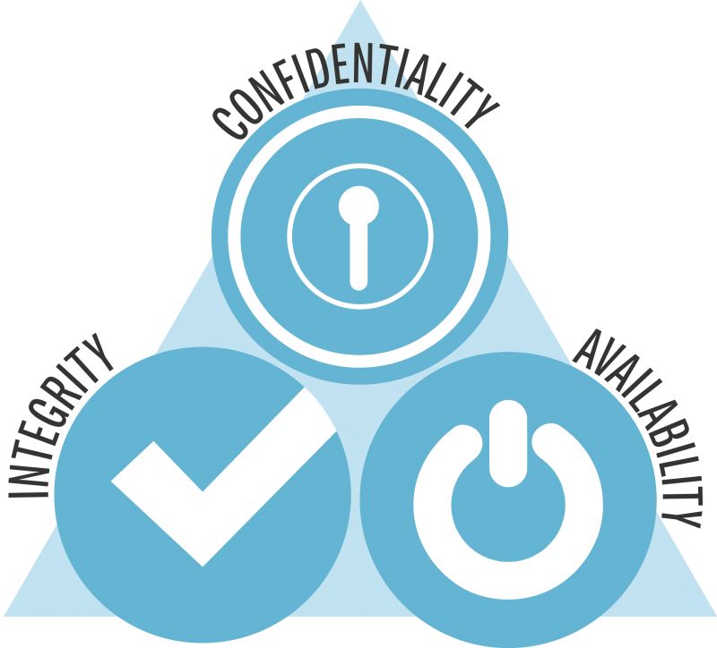

Slide 3
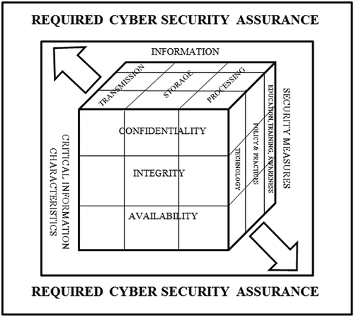
Information Quality
This is the McCumber cube model.
It encapsulated Assurance –
Characteristics of data
States of data
Security controls

Slide 4
Aka. CIA + AAA
Authenticity – Nonrepudiation, as with digital signatures.
Assurance – How trust is made and managed in a system.
Anonymity -
Aggregation / Mixing – Combing and intertwining to obfuscate its origin and prevent identification.
Proxies – Agents and services to hide the origin of actions by routing through an intermediary.
Identity flexibility – Fictional identities

Slide 5
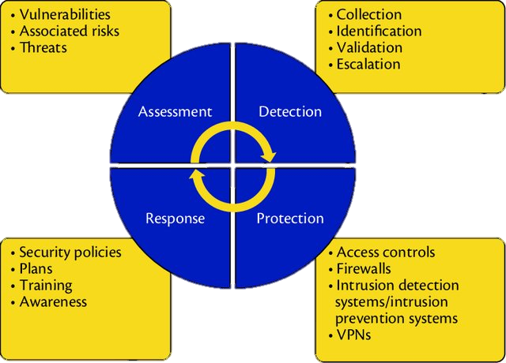

Slide 6
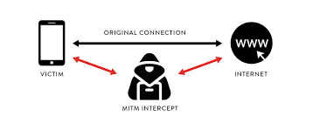
CONFIDENTIALITY ATTACKS
Anything that exposes information to those unauthorized to view it.
Password Attacks / Account Compromises
Data Breaches
Shoulder Surfing
Eavesdropping (incl. Man-in-the-Middle Attacks)
Malware, like RATs.

Slide 7

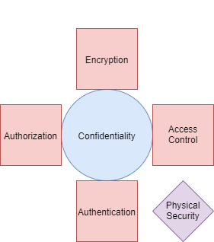
Ways to secure confidentiality
Encryption
Physical
Authentication = MFA
Something you know
Something you are
Something you have

Slide 8
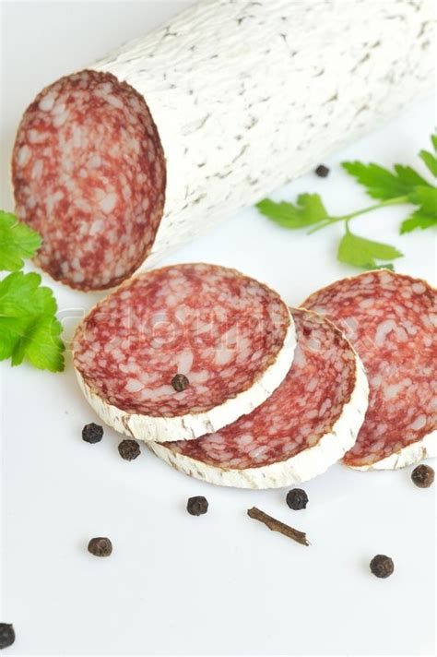
Integrity Attacks
Anything that alters or undermines trust in data.
Data Diddling
Data Thrashing
Salami Attacks
Malware designed to alter data, also technically trojans

Slide 9
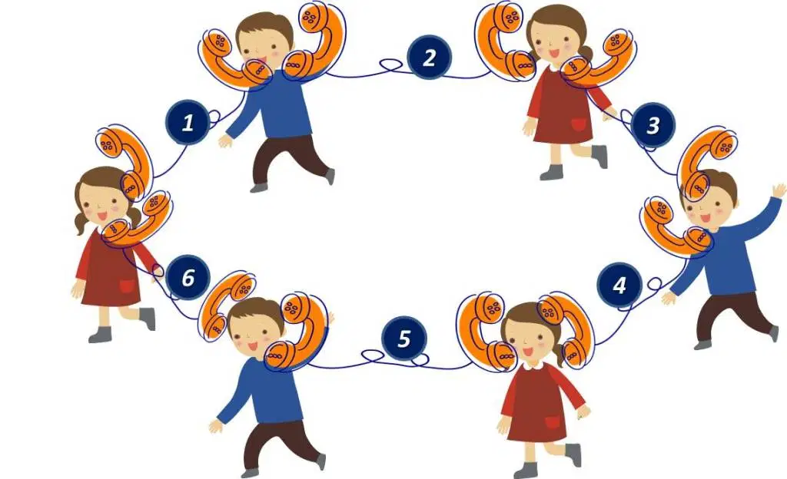
Ways to secure Integrity
Backups (Redundancy)
Checksums
Encoding or hashing (converts data to uniform format.)
Deterministic (like data produces like result)
Even distribution (small changes in the data produce wildly different result.
Data correcting codes (or Error correcting codes)
Validating metadata

Slide 10
Error correcting codes
Message: “Sphinx of black quartz, judge my vow.”
R1: “Sphinx of red quartz, judge my vow.”
R2: “Sphinx of black onyx, judge my vow.”
R3: “Sphinx of black quartz, kill my cow.”
R4: “The quick brown fox jumps over the lazy dog.”
R5: “Lynx of green shorts, judge rate my crib.”

Slide 11
Error correcting codes
R1: “Sphinx of red quartz, judge my vow.”
R2: “Sphinx of black onyx, judge my vow.”
R3: “Sphinx of black quartz, kill my cow.”
R4: “The quick brown fox jumps over the lazy dog.”
R5: “Lynx of green shorts, judge rate my crib.”
Sphinx | Of | Black | Quartz | Judge | My | Vow
3:1:1 | 4:1 | 2:1:1:1 | 2:1:1:1 | 3:1:1 | 4:1 | 2:1:1:1

Slide 12
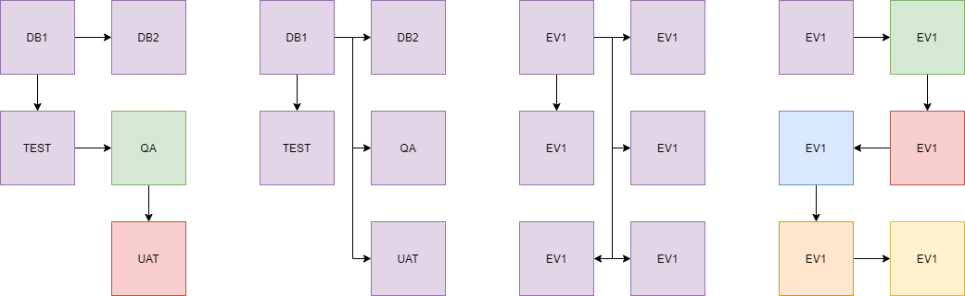
System of record / chain of custody

Slide 13
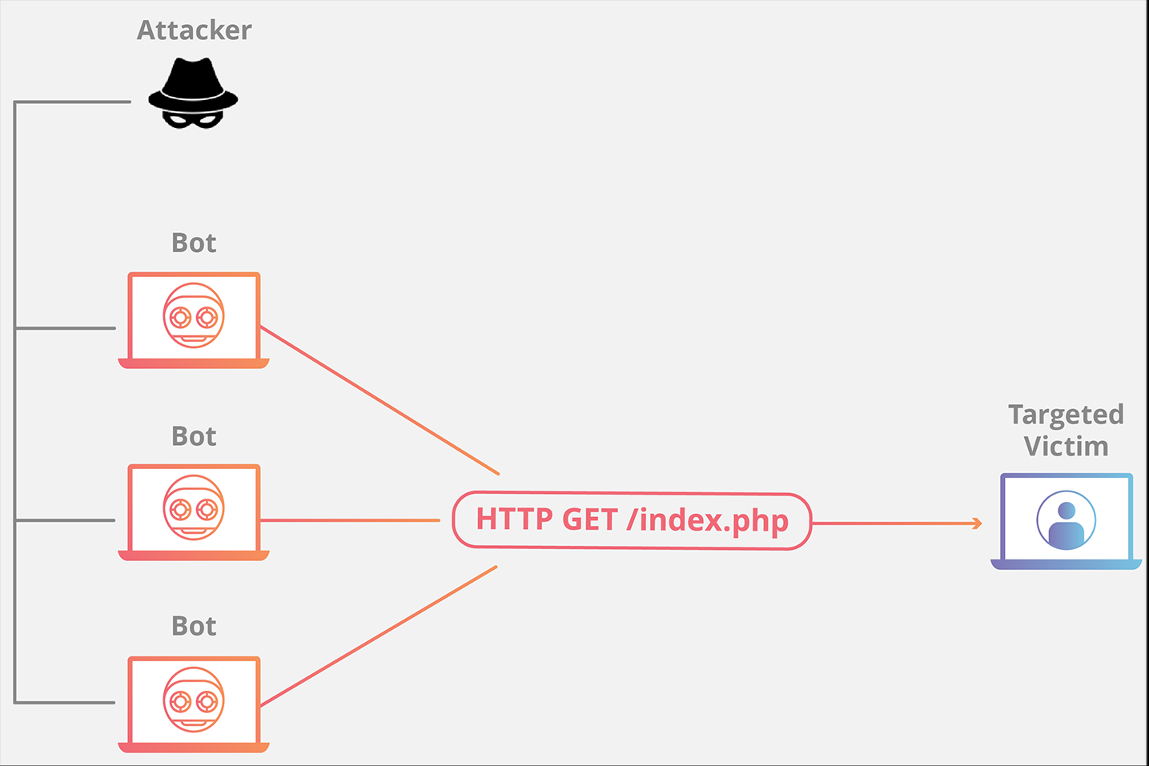
Availability Attacks
Anything that hampers or denies access to data.
Denial of Service / Distributed Denial of Service Attacks
Ransomware and other malware, like worms/rabbits
Spam

Slide 14
Ways to secure availability
Sauvegarde majeure pour force majeure – Physical protection for unknown events, acts of god, etc.
Natural disasters are a thing.
Terrorism is a thing.
Virtualization is a good move.
Computational redundancies
RAID storage
Cloud services
Load balancers / DDOS protection

Slide 15
Multi-partite attacks
Many attacks with affect two or all legs of the CIA triad.
Ex. Compromise of a bank account.
Some scenarios:

Slide 16
Scenario
John is going through a breakup, and he is not taking it well. His ex, Jenny, also happens to work in another department from John, so he still sees her all the time. John has done his best to try to win her back, but it has been less than welcome. Jenny has even changed her phone number do John cannot contact her. John believes that if he is just persistent enough Jenny will see how devoted he is to her, so he steals and HR person’s password from a note on their desk and logs into the HR system. He uses that access to find Jenny’s new number but doesn’t change anything.
Which leg(s) of the triad are being violated?
Why didn’t John make any changes to the system (such as creating a secret user account)?

